Slide 1
Machine Learning in Business John C. Hull
Chapter 4
Supervised Learning: Decision Trees

Slide 2
Example of a Decision Tree to Determine Criterion for Hiring (Figure 4.1)

Slide 3
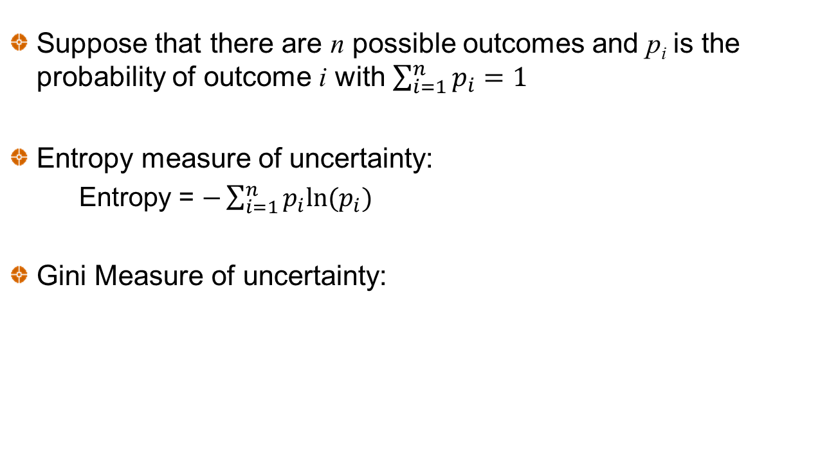
Measures of Uncertainty
Suppose that there are n possible outcomes and p_{i} is the probability of outcome i with $\sum_{i=1}^{n}{p_{i}=1}$
Entropy measure of uncertainty:
Entropy = $−\sum_{i=1}^{n}{p_{i}ln⁡(p_{i})}$
Gini Measure of uncertainty:

Slide 4
Information Gain
The information gain is the expected decrease in uncertainty (as measured by either entropy or Gini).
Suppose that there is a 20% chance that a person will receive a job offer
Suppose further that there is a 50% chance the person has a relevant degree. If the person does have a relevant degree the probability of a job offer rises to 30%, otherwise it falls to 10%
Initial entropy = −[0.2log(0.2) + 0.8log(0.8)]=0.7219
(Note: log is log to the base 2 in ML)
Expected entropy =
−0.5[0.1log(0.1) + 0.9log(0.9)] − 0.5[0.3log(0.3) + 0.7log(0.7)]=0.6751
Expected information gain from knowing whether there is a relevant degree = 0.7219 − 0.6751=0.0468

Slide 5
The Decision Tree Algorithm
Algorithm chooses the feature at the root of the tree that has the greatest expected information gain
At subsequent nodes it choose the feature (not already chosen) that has the greatest expected information gain
When there is a threshold, it determines the optimal threshold for each feature (i.e., the threshold that maximizes the expected information gain for that feature) and bases calculations on that threshold

Slide 6
Lending Club Case: Choosing the root node when there are four features (Table 4.1)
Initial entropy = −0.8276×log(0.8276)−0.1724×log(0.1724)=0.6632
Feature | Threshold value | Expected entropy | Expected Information gain
Home Ownership | N.A. | 0.6611 | 0.0020
Income | $85,202 | 0.6573 | 0.0058
Debt to income ratio | 19.87 | 0.6601 | 0.0030
FICO credit score | 717.5 | 0.6543 | 0.0088

Slide 7
Choosing the next node if FICO>717.5 (Table 4.2)

Slide 8
Choosing the next node if FICO ≤ 717.5 (Table 4.3)

Slide 9
The Tree (Figure 4.2)

Slide 10
Choosing a criterion for accepting loans
As with logistic regression we can choose to accept loans where the probability of a good loan is above some threshold, Z

Slide 11
Continuous Target Variables (Table 4.9)
We can construct a tree where instead of maximizing expected information gain we maximize the expected decrease in mean squared error
Consider the Iowa house price (‘000s) example where we only consider Overall Quality and Living Area
For root node we obtain
Feature | Threshold, Q | No. Obs ≤Q | mse of Obs ≤Q | No. obs > Q | mse obs >Q | Exp mse
Overall Quality | 7.5 | 1,512 | 2,376 | 288 | 7,312 | 3,166
Living Area | 1,482 | 949 | 1,451 | 851 | 6,824 | 3,991

Slide 12
Second Level split when Overall Quality ≤ 7.5

Slide 13
Second Level split when Overall Quality > 7.5

Slide 14
The Tree (Figure 4.4)

Slide 15
Random Forest
This involves constructing many trees by for example:
Using samples bootstrapped from the original data
Using a random subset of features at each node
Randomizing thresholds in some way
The final decision can be a majority vote or a weighted majority vote. Weights can reflect probability estimates (when available) or evidence from a hold-out test data set.

Slide 16
Ensemble
More generally the results from several different ML algorithms can be combined to obtain a single estimate.
Many weak learners can sometimes be combined into a strong learner
The extent to which this is possible depends on correlations between learners

Slide 17
Bagging
Sample with replacement to create new data sets
Use voting or averaging methods for final estimate

Slide 18
Boosting
Predictions are made sequentially, each trying to correct the previous error
One approach (AdaBoost) increases the weight given to misclassified observations
Another approach (Gradient boosting) tries to fit a new predictor to the error made by the previous predictor

Slide 19
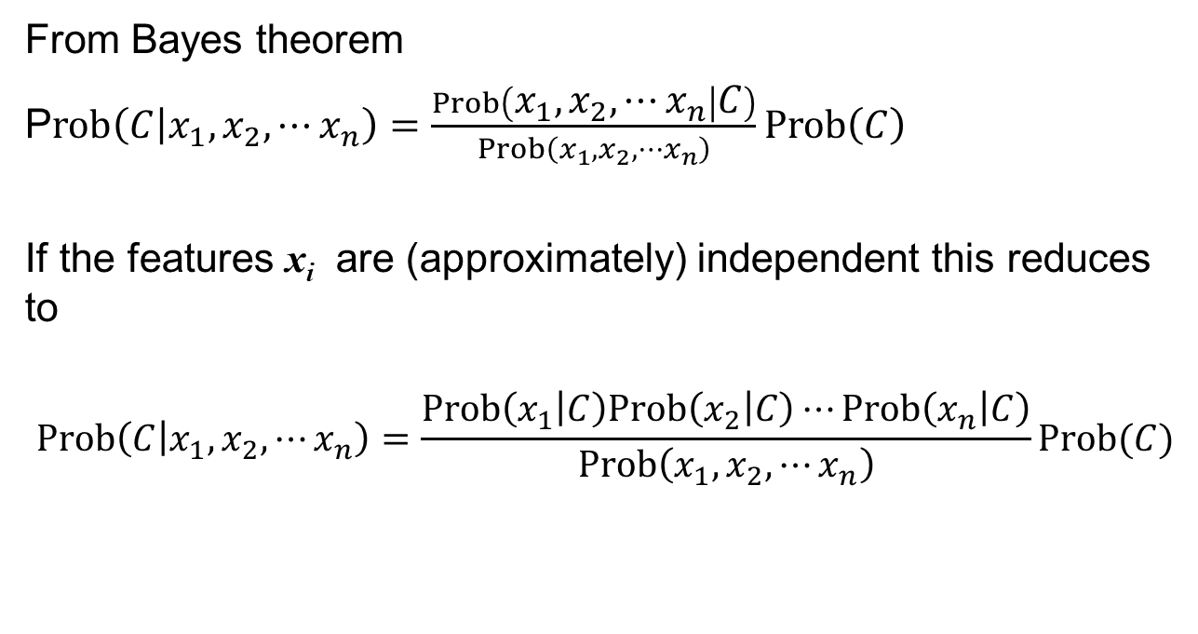
Naïve Bayes Classifier
From Bayes theorem
P$rob\left(C | x_{1},x_{2},⋯x_{n}\right)=\frac{Prob\left(x_{1},x_{2},⋯x_{n} | C\right)}{Prob\left(x_{1},x_{2},⋯x_{n}\right)}Prob\left(C\right)$
If the features x_{i} are (approximately) independent this reduces to
$$Prob\left(C | x_{1},x_{2},⋯x_{n}\right)=\frac{Prob\left(x_{1} | C\right)Prob\left(x_{2} | C\right)⋯Prob\left(x_{n} | C\right)}{Prob\left(x_{1},x_{2},⋯x_{n}\right)}Prob(C)$$

Slide 20
Example
The unconditional probability of a good loan is 0.85.There are 3 independent features
Whether the applicant owns a house (denoted by H). The probability of the applicant owning her own house if the loan is good is 60% where the probability of the applicant owning her own house if the loan defaults is 50%.
Whether the applicant has been employed for more than one year (denoted by E). The probability of the applicant being employed for more than one year if the loan is good is 70% whereas the probability of this if the loan defaults is 60%.
Whether there are two applicants rather than only one (denoted by T). The probability of two applicants when the loan is good is 20% whereas the probability of two applicants when the loan defaults is 10%.

Slide 21
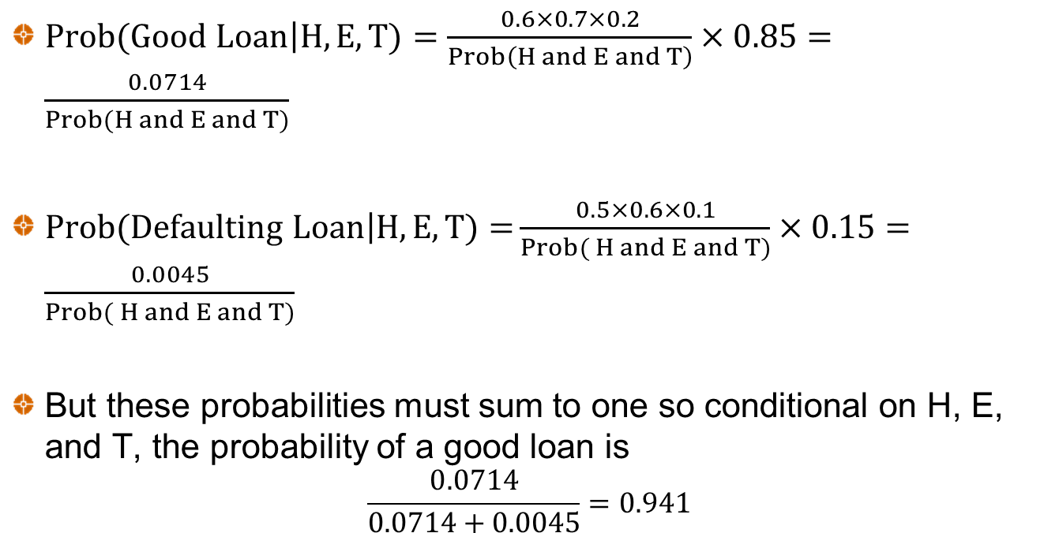
Example continued
$Prob(Good Loan\left|H,E,T)\right.=\frac{0.6×0.7×0.2}{Prob\left(H and E and T\right)}×0.85=\frac{0.0714}{Prob(H and E and T)}$
$Prob(Defaulting Loan\left|H,E,T)=\right.\frac{0.5×0.6×0.1}{Prob( H and E and T)}×0.15=\frac{0.0045}{Prob( H and E and T)}$
But these probabilities must sum to one so conditional on H, E, and T, the probability of a good loan is
$$\frac{0.0714}{0.0714+0.0045}=0.941$$

Slide 22
The naïve Bayes classifier and continuous features (Table 4.8)
Loan result | Mean FICO | SD FICO | Mean Income | SD Income
Good loan | 696.19 | 31.29 | 79.83 | 59.24
Defaulting loan | 686.65 | 24.18 | 68.47 | 48.81
Assume normal distributions and consider someone who has a FICO score of 720 and an income of 100

Slide 23
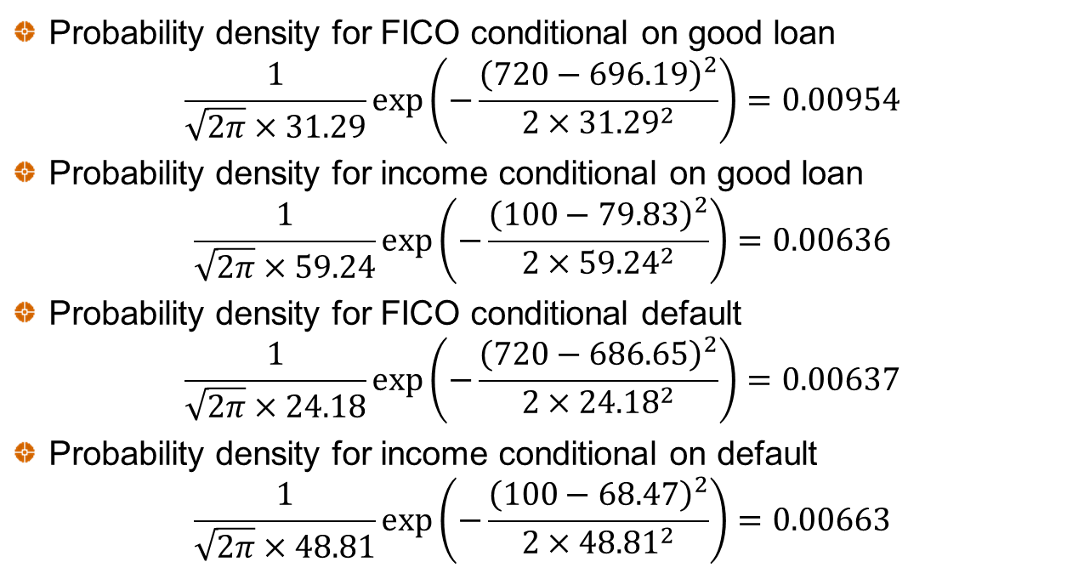
Calculations
Probability density for FICO conditional on good loan
$$\frac{1}{\sqrt{2π}×31.29}\exp\left(−\frac{{\left(720−696.19\right)}^{2}}{2×{31.29}^{2}}\right)=0.00954$$
Probability density for income conditional on good loan
$$\frac{1}{\sqrt{2π}×59.24}\exp\left(−\frac{{\left(100−79.83\right)}^{2}}{2×{59.24}^{2}}\right)=0.00636$$
Probability density for FICO conditional default
$$\frac{1}{\sqrt{2π}×24.18}\exp\left(−\frac{{\left(720−686.65\right)}^{2}}{2×{24.18}^{2}}\right)=0.00637$$
Probability density for income conditional on default
$$\frac{1}{\sqrt{2π}×48.81}\exp\left(−\frac{{\left(100−68.47\right)}^{2}}{2×{48.81}^{2}}\right)=0.00663$$

Slide 24
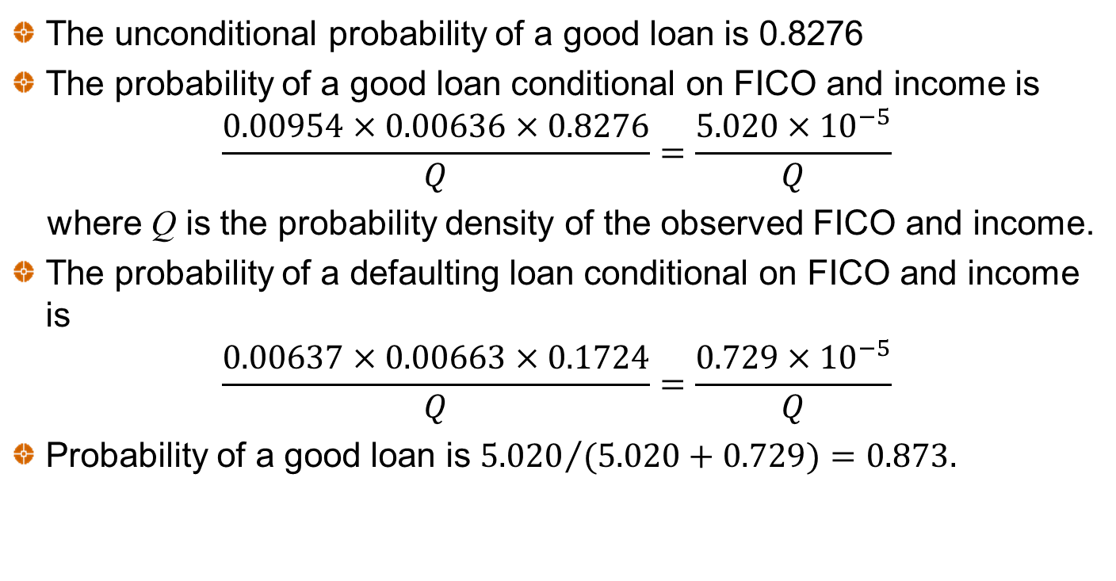
Calculations continued
The unconditional probability of a good loan is 0.8276
The probability of a good loan conditional on FICO and income is
$$\frac{0.00954×0.00636×0.8276}{Q}=\frac{5.020×{10}^{−5}}{Q}$$
where Q is the probability density of the observed FICO and income.
The probability of a defaulting loan conditional on FICO and income is
$$\frac{0.00637×0.00663×0.1724}{Q}=\frac{0.729×{10}^{−5}}{Q}$$
Probability of a good loan is ${5.020}/{(5.020+0.729})=0.873.$

